Slide 1

Data Challenge -
VeO Ride Inc.
2021 UMD DATA CHALLENGE
Date 02/27/2021
Team DC21012

Slide 2





Agenda
Overview
Problem Statement
Data Dictionary
COVID 19 Impact
Results & Insights
Recommendations
Questions

Slide 3





About Analysis
OUR DATA
OBJECTIVE
METHODOLOGY
INSIGHTS & RESULTS
RECOMMENDATION

Slide 4
Overview

Slide 5

Our Data
The Data is from VeoRide Inc - an e-scooter service provider in the UMD area.
The Data contains information about around 40,325 rides spread across two months - October 2019 and October 2020.

Slide 6

Objective
To analyse the data to generate insights on ride patterns.
To help improve Better Living conditions for the Customers while Innovating to improve benefits for the company

Slide 7

Methodology
Pattern Analysis on Data across different variables
Graphs and Plots to understand impactful points and insights
New Parameters to understand data effectively and to raise any concerns

Slide 8
Innovation
We used reverse geocoding to get addresses for starting locations and destinations. These addresses were used to find route patterns.
We split the path variable into individual point coordinates. Next, we compared these against the UMD boundaries to find campus entrance and exit points
We added daily weather information to our data to provide additional insight and understand the effect of daily weather on ride patterns

Slide 9
COVID-19 Impact

Slide 10

COVID-19 Impact
How has COVID-19 impacted ridership ?
What measures are highly indicative of that impact?
What can be useful recommendations and insights for VeoRide to improve business ?

Slide 11
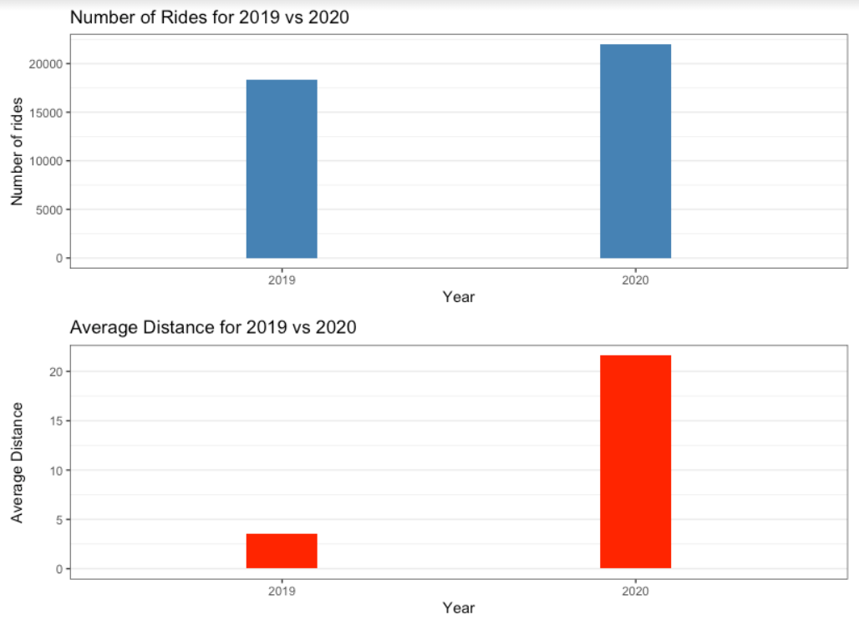
Ridership
The number of riders increased substantially from 2019 to 2020 while the average distance of rides increased exponentially.
One possible reason could be reluctance of commuters to use public transport due to the COVID-19 pandemic.

Slide 12
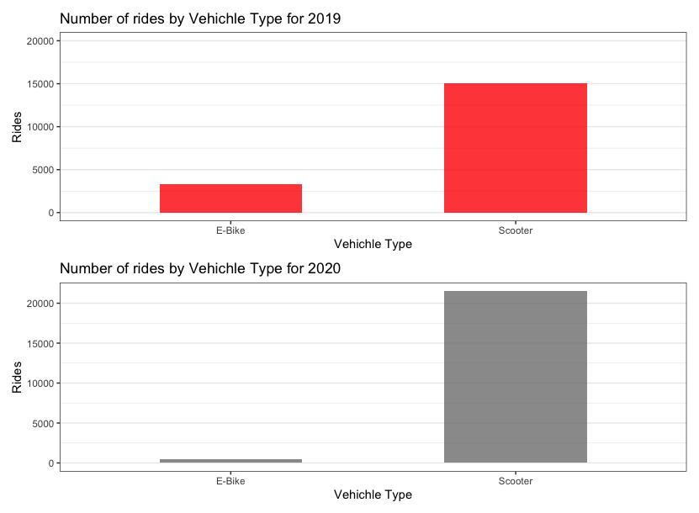
Rides by Vehicle Type
The graph shows the number of rides by each Vehicle Type and shows the difference between 2019 and 2020.
More people started travelling on scooters and thus the numbers increased during 2020.
The preference for E-Bikes was low and it dropped drastically in 2020 with extremely less number of people travelling on E-bikes.

Slide 13
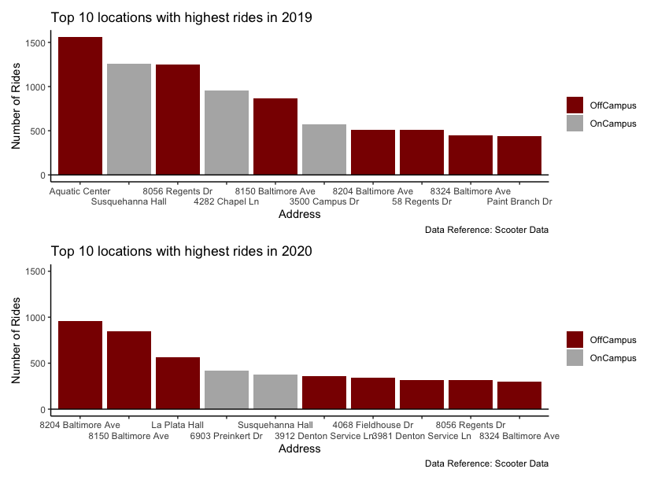
Start Locations
This indicates top 10 locations by number of rides and shows on campus vs off campus locations
It shows more number of rides starting off campus and it decreased even further in 2020 with campus starting points being less frequently used
It thus shows people coming less to campus due to COVID-19 restrictions and more number of rides starting outside campus
Also it gives the best locations where maximum ridership is found and thus can be used to increase availability of bikes and scooters at these locations

Slide 14
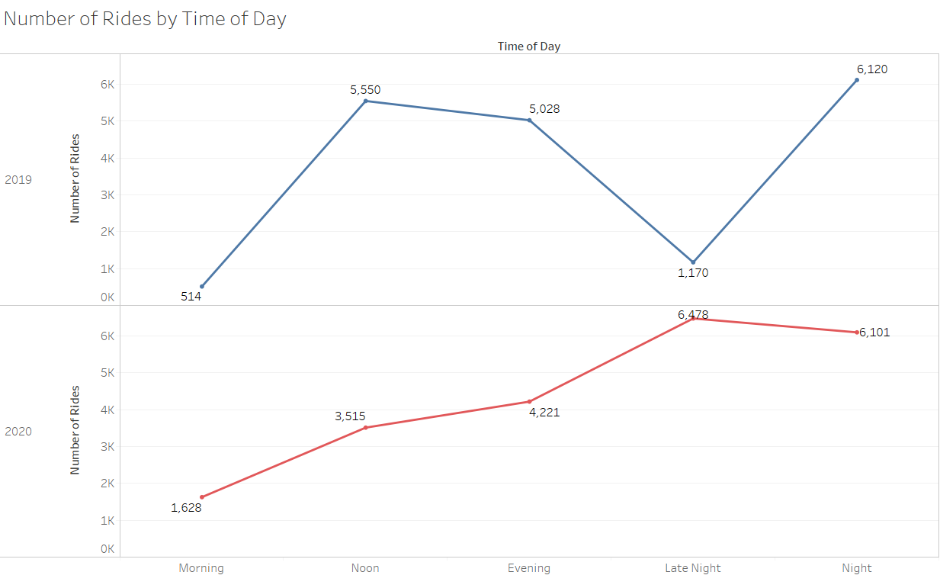
Rides during different Day Times
The trend changes from 2019 to 2020 with number of rides increasing from Morning till night and shows riders increased preference to travel at night.
Also the number of rides shifted from noon to evening and night and thus shows a decrease from 2019 to 2020.

Slide 15
Insights and Results

Slide 16
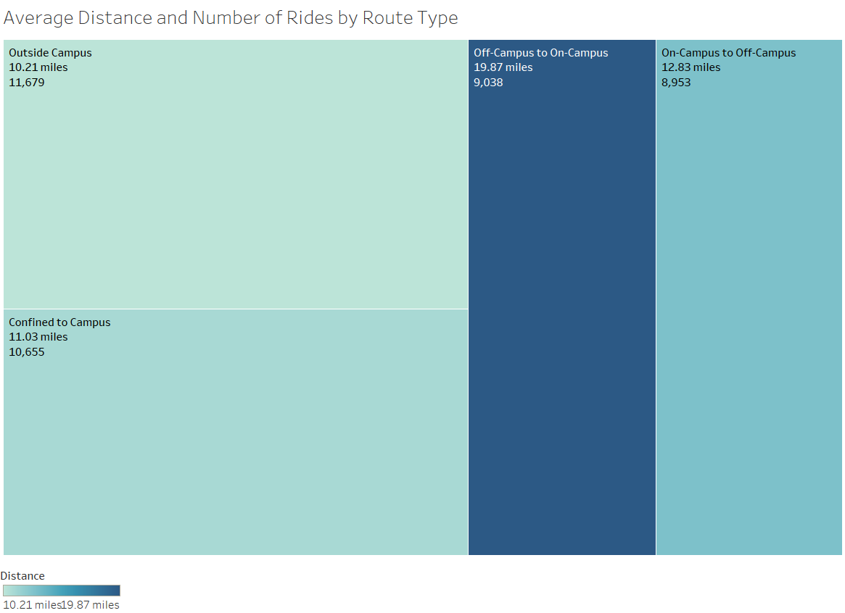
Average Distance & Rides by Route Type
Most of the rides are either confined within the campus or entirely off-campus.
Rides starting off-campus and coming into campus are significantly longer than all other route types.

Slide 17
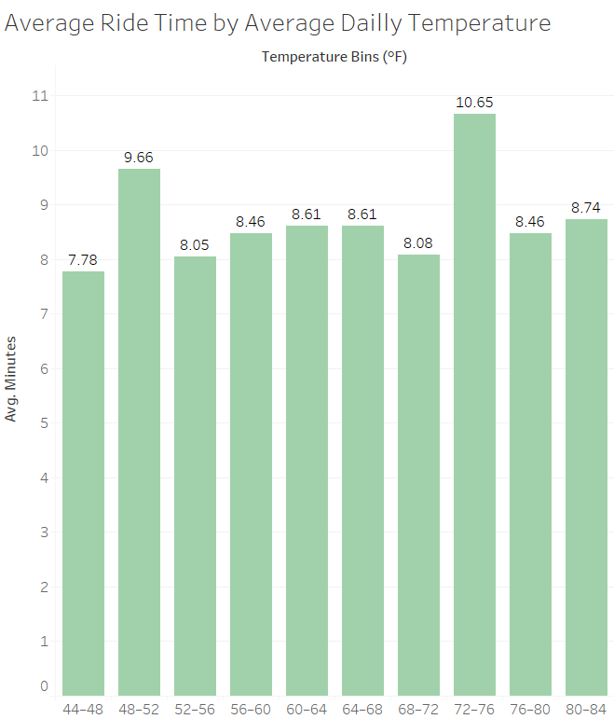
Average Ride Time by Average Temperature
All rides take place on days where the average temperature was between 44°F and 84°F.
This range could be significant as commuters might hesitate using e-bikes and scooters during extreme temperatures.
Rides on days where the temperature was between 72°F to 76°F had the highest average ride times.

Slide 18
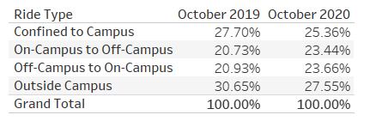
Significant Results
The most used campus exit was 7952 Paint Branch Drive and the most used campus entrance was Stadium Drive.
The most common routes were from 8056 Regents Drive and Susquehanna Hall to Aquatic Center, 4098 Valley Drive.
A lot of common routes were also round trips to and from 8204 Baltimore Ave and 8056 Regents Drive respectively.
The distribution of rides across the two time periods is as follows:

Slide 19
Impact & Recommendations

Slide 20
Cultivating Better Living
Our project works on increasing user comfort by reducing any wait time or the distance travelled to get an e-Scooter. The business model deployment is independent of human interference and thus reduces the cost and increases the comfort and reliability.
For short distances, if the frequency of public transport is low or waiting times are high (which is generally due to low ridership), the time can be saved by using this micro mobility. This also can help a great deal during inclement weather conditions. This helped UMD augment the already present bus transit system. It helps solve the problem of end point connectivity.

Slide 21
WHO- Quality of Life
Energy and Fatigue - Energy, enthusiasm and endurance that a person has in order to perform the necessary tasks of daily living, as well as other chosen activities such as recreation increase cause of reduced walking exertion.
Mobility - With the availability of transportation at all times at low cost, the tension of mobility is no more.
Freedom, physical safety and security - Independence from others increases this sense.

Slide 22
Recommendations
Reducing frequency of storing timestamps
Focusing on high demand areas
Avoid less charging problems
Collecting customer data for customer segment analysis

Slide 23
References
Shah, Nitesh, "Big Data and Unsupervised Machine Learning Approach to Understand Why People Ride EScooter in Nashville, Tennessee. " Master's Thesis, University of Tennessee, 2020. https://trace.tennessee.edu/utk_gradthes/5554
https://data.imap.maryland.gov/datasets/maryland-campus-facilities-umd-administrative-boundary
https://www.ncdc.noaa.gov/cdo-web/search

Slide 24
Thank you
Questions?

